Slide 1

SQL Server Common Table Expressions
Steve Stedman
Everything You Ever Wanted to Know About Common Table Expressions
http://SteveStedman.com
Follow me on Twitter @SqlEmt

Slide 2
About Steve Stedman
DBA/Consultant/Trainer/Speaker/Writer
Been using SQL Server since 1990 (SQL Server 1.0 for OS/2)
Taught SQL Server classes at WWU
SQL Server consultant
Developer of the Database Health Project
http://DatabaseHealth.SteveStedman.com
Working at Emergency Reporting as CTO
Volunteer Firefighter and EMT
http://SteveStedman.com for more information.

Slide 3
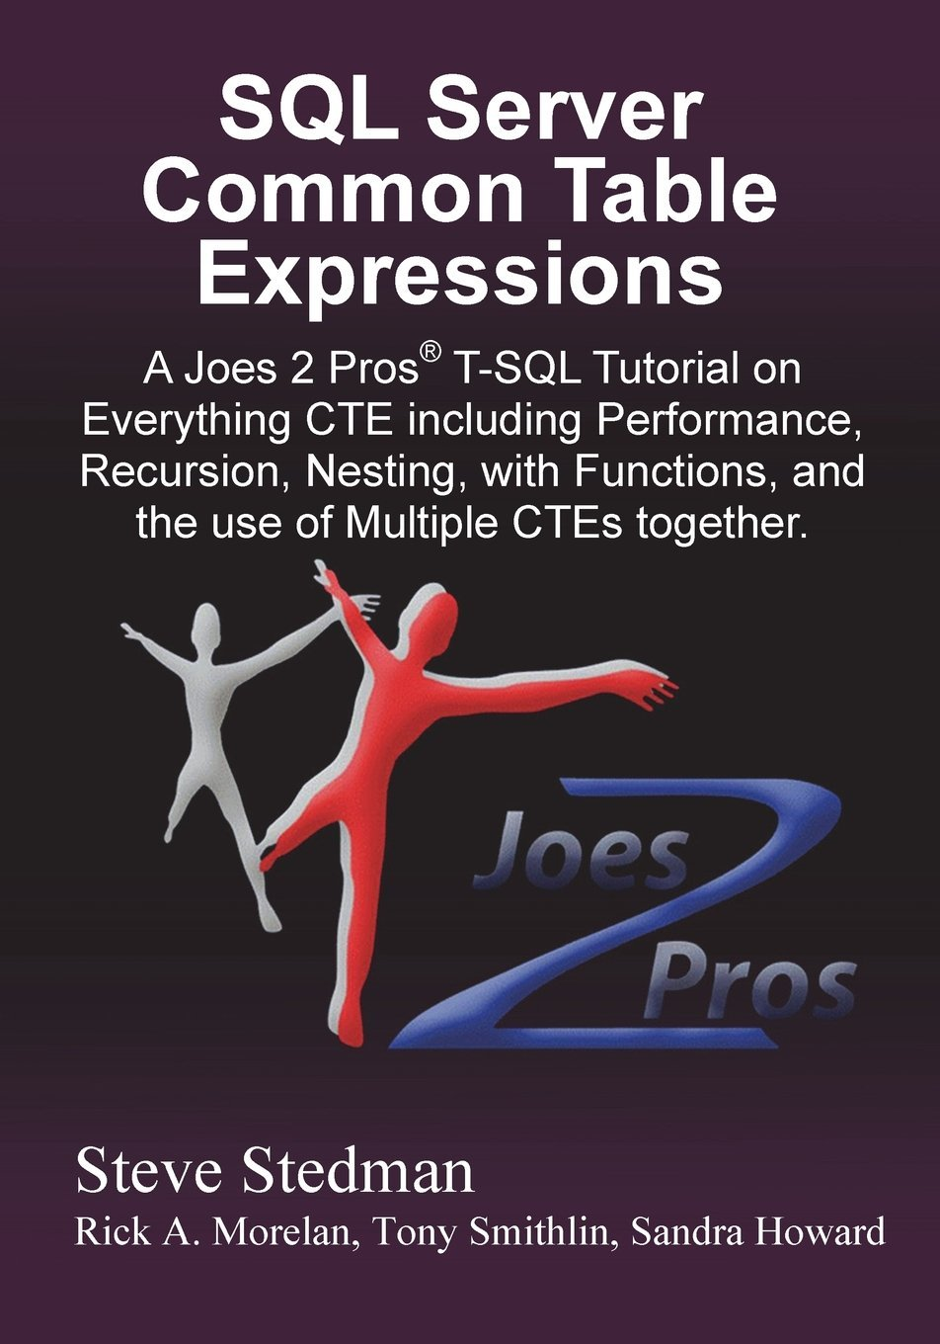
Common Table Expressions Book
Published May 2013
Available at Amazon.com and at Joes2Pros.com
Printed and Kindle are both available now

Slide 4
Prerequisites
To get the most value out of this presentation you should:
Be familiar with TSQL and able to write queries.
Have experience with derived table queries (subqueries)
Understand execution plans

Slide 5
Presentation Overview - CTE
What is a Common Table Expression
Simple CTE
CTE instead of a Derived Table
Recursive CTE
Multiple CTEs in a Query
CTE Common Uses
Manipulating Data with a CTE
CTE for Math Geeks

Slide 6
1. What is a Common Table Expression?
A type of a virtual table
Similar to the ease of a temporary table
Sort of like a derived table
Like a temporary named result set
Acts like a temporary view, or a run time view

Slide 7
Availability of CTEs
TRANSACT SQL feature that I wish I had learned about 8 years ago, CTE’s were introduced in SQL Server 2005
All versions of SQL Server since SQL 2005 and all variations of SQL Server support CTEs
CTEs are also available in SQL Azure.

Slide 8
Why Use Common Table Expressions?
Simplify your query – test one part at a time
Recursion
Computer Science: When a function calls itself
SQL Server: When a query calls itself
Make derived table queries more readable
Alternative to a temp table or a table variable

Slide 9
CTE Syntax - WITH
Queries start with ;WITH not SELECT
Can be confusing if you are assuming that any query to select data would start with a SELECT
The scope of the CTE is confined to a single query
A CTE just seems a little weird, until you master the syntax

Slide 10
2. Simple CTE Syntax
;WITH

Slide 11
2. Simple CTE Syntax
;WITH expression_name

Slide 12
2. Simple CTE Syntax
;WITH expression_name [(column_name[,...n])]

Slide 13
2. Simple CTE Syntax
;WITH expression_name [(column_name[,...n])]
AS

Slide 14
2. Simple CTE Syntax
;WITH expression_name [(column_name[,...n])]
AS
( CTE_query_definition )

Slide 15
2. Simple CTE Syntax
;WITH expression_name [(column_name[,...n])]
AS
( CTE_query_definition )
SELECT <column_list>
FROM expression_name;

Slide 16
Demo: Simple CTE
;WITH departmentsCTE

Slide 17
Demo: Simple CTE
;WITH departmentsCTE (id, department, parent)

Slide 18
Demo: Simple CTE
;WITH departmentsCTE (id, department, parent)
AS
(
SELECT id, department, parent
FROM Departments
)

Slide 19
Demo: Simple CTE
;WITH departmentsCTE (id, department, parent)
AS
(
SELECT id, department, parent
FROM Departments
)
SELECT *
FROM departmentsCTE;

Slide 20
Demo

Slide 21
Reminder
If a CTE is not the first statement in a batch it must be proceeded with a semicolon

Slide 22
3. CTE Instead of a Derived Table
Simplifies the query – allows for clean code
Does not improve the performance
More value for large derived table queries in that the TSQL is cleaner and easier to read and understand
Eliminates accidents by duplicating derived table queries TSQL code

Slide 23
Derived Table Without a CTE
SELECT q1.department, q2.department
FROM (SELECT id, department, parent
FROM Departments) as q1
INNER JOIN (SELECT id, department, parent
FROM Departments) as q2
ON q1.id = q2.parent
WHERE q1.parent is null;

Slide 24
Steps to Convert a Derived Table to a CTE
Find the first occurrence of the derived table query to be broken out. Create a name for it and add “CTE” to the name.
Copy the derived table definition, including the parentheses, and leave the new name as the placeholder.
Paste the query, copied earlier, above the SELECT statement.
At the top of the query add the CTE declaration using the same name from step 1.
Find all other occurrences of the same derived table query and replace them with the CTE name.
Clean up the formatting and test the query.

Slide 25
CTE for Derived Table Re-use
;WITH deptCTE(id, department, parent) AS
(SELECT id, department, parent
FROM Departments)
SELECT q1.department, q2.department
FROM deptCTE q1
INNER JOIN deptCTE q2 on q1.id = q2.parent
WHERE q1.parent is null;

Slide 26
CTE Instead of a Derived Table Summary
Most derived tables can be easily converted to a CTE
Copy and paste errors can be reduced by using a CTE
Using a CTE doesn’t improve the performance over a similar query written with derived tables
For a CTE that is referenced multiple times the CTE query is not reused, it is executed multiple times

Slide 27
4. Recursive CTE
Considered recursive when the CTE references itself
Recursion stops
When the second SELECT produces no results
Or specify MAXRECURSION
Uses
Hierarchical listing of categories
Recursive calculations
Much, much more…

Slide 28
Recursive Terminology
Anchor Query
Start the recursion
Recursive Query
The part that repeats
MAXRECURSION
The number of times to repeat the recursive query
Default is 100
MAXRECURSION of 0 implies no maximum

Slide 29
Recursion Overview
Sum the numbers from 1 to 10 without recursion
55 = 10 + 9 + 8 + 7 + 6 + 5 + 4 +3 + 2 + 1
Sum the numbers from 1 to 10 recursively
55 = 10 + (sum of numbers 1 to 9) 55 = 10 + (9 + (sum of numbers 1 to 8)) 55 = 10 + (9 + (8 + (sum of numbers 1 to 7)))
Eventually we get to:
55 = 10 + (9 + (8 + (7 + (6 + (5 + (4 + (3 + (2 + 1))))))))

Slide 30
Example of How a Recursive CTE Works
Select some starting set of data from table A.
Join that starting set of data to table A.
For the results from step 2, join that to Table A.
Repeat until there are no more items produced by the join.

Slide 31
Demo: Recursive CTE
;WITH DepartmentCTE(DeptId, Department, Parent, Level) AS
Step 1. Declare the CTE and Columns

Slide 32
Demo: Recursive CTE
;WITH DepartmentCTE(DeptId, Department, Parent, Level) AS
( SELECT id as DeptId, Department, parent, 0 as Level
FROM Departments
WHERE parent is NULL
Step 2 – Add the Anchor Query

Slide 33
Demo: Recursive CTE
;WITH DepartmentCTE(DeptId, Department, Parent, Level) AS
( SELECT id as DeptId, Department, parent, 0 as Level
FROM Departments
WHERE parent is NULL
UNION ALL
Step 3 – Add the UNION ALL to connect to the recursive query

Slide 34
Demo: Recursive CTE
;WITH DepartmentCTE(DeptId, Department, Parent, Level) AS
( SELECT id as DeptId, Department, parent, 0 as Level
FROM Departments
WHERE parent is NULL
UNION ALL -- and now for the recursive part
SELECT d.id as DeptId, d.Department, d.parent,
DepartmentCTE.Level + 1 as Level
FROM Departments d
INNER JOIN DepartmentCTE
ON DepartmentCTE.DeptId = d.parent)
Step 4 – Add the recursive Query

Slide 35
Demo: Recursive CTE
;WITH DepartmentCTE(DeptId, Department, Parent, Level) AS
( SELECT id as DeptId, Department, parent, 0 as Level
FROM Departments
WHERE parent is NULL
UNION ALL -- and now for the recursive part
SELECT d.id as DeptId, d.Department, d.parent,
DepartmentCTE.Level + 1 as Level
FROM Departments d
INNER JOIN DepartmentCTE
ON DepartmentCTE.DeptId = d.parent)
SELECT *
FROM DepartmentCTE
ORDER BY parent;

Slide 36
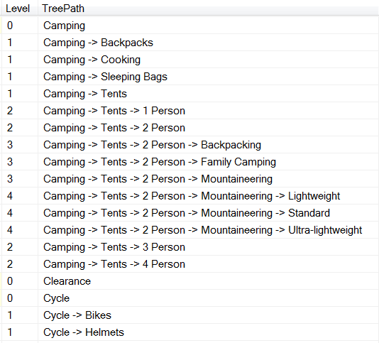
Recursive CTE with Tree Path
Tree Path shows the department and all parent departments.
Simple to do with a recursive CTE

Slide 37
Demo: Recursive CTE with Tree Path
;WITH DepartmentCTE
(DeptId, Department, Parent, Level, TreePath)
AS
Step 1. Declare the CTE and Columns

Slide 38
Demo: Recursive CTE with Tree Path
;WITH DepartmentCTE(DeptId, Department, Parent, Level, TreePath) AS
( SELECT id as DeptId, Department, parent, 0 as Level,
cast(Department as varchar(1024)) as TreePath
FROM Departments
WHERE parent is NULL
Step 2 – Add the Anchor Query

Slide 39
Demo: Recursive CTE with Tree Path
;WITH DepartmentCTE(DeptId, Department, Parent, Level, TreePath) AS
( SELECT id as DeptId, Department, parent, 0 as Level,
cast(Department as varchar(1024)) as TreePath
FROM Departments
WHERE parent is NULL
UNION ALL -- and now for the recursive part
Step 3 – Add the UNION ALL to connect to the recursive query

Slide 40
Demo: Recursive CTE with Tree Path
;WITH DepartmentCTE(DeptId, Department, Parent, Level, TreePath) AS
( SELECT id as DeptId, Department, parent, 0 as Level,
cast(Department as varchar(1024)) as TreePath
FROM Departments
WHERE parent is NULL
UNION ALL -- and now for the recursive part
SELECT d.id as DeptId, d.Department, d.parent,
DepartmentCTE.Level + 1 as Level,
cast(DepartmentCTE.TreePath + ' -> ' +
d.department as varchar(1024)) as TreePath
FROM Departments d
INNER JOIN DepartmentCTE
ON DepartmentCTE.DeptId = d.parent)
Step 4 – Add the recursive Query

Slide 41
Demo: Recursive CTE with Tree Path
;WITH DepartmentCTE(DeptId, Department, Parent, Level, TreePath) AS
( SELECT id as DeptId, Department, parent, 0 as Level,
cast(Department as varchar(1024)) as TreePath
FROM Departments
WHERE parent is NULL
UNION ALL -- and now for the recursive part
SELECT d.id as DeptId, d.Department, d.parent,
DepartmentCTE.Level + 1 as Level,
cast(DepartmentCTE.TreePath + ' -> ' +
d.department as varchar(1024)) as TreePath
FROM Departments d
INNER JOIN DepartmentCTE
ON DepartmentCTE.DeptId = d.parent)
SELECT *
FROM DepartmentCTE
ORDER BY TreePath;

Slide 42
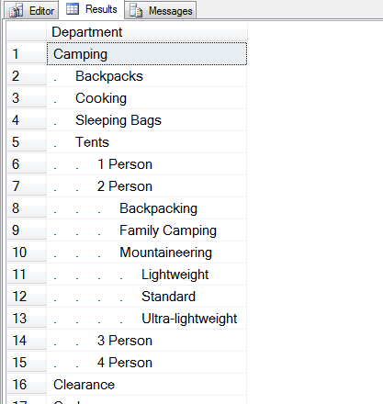
Recursive CTE with Indentation
Simple add on to Tree Path query
Still using Tree Path for sort order
Using the SQL Server REPLICATE function to indent the category.

Slide 43
Recursive CTE with Indentation
;WITH DepartmentCTE(DeptId, Department, Parent, Level, TreePath) AS
( SELECT id as DeptId, Department, parent, 0 as Level,
cast(Department as varchar(1024)) as TreePath
FROM Departments
WHERE parent is NULL
UNION ALL -- and now for the recursive part
SELECT d.id as DeptId, d.Department, d.parent,
DepartmentCTE.Level + 1 as Level,
cast(DepartmentCTE.TreePath + ' -> ' +
d.department as varchar(1024)) as TreePath
FROM Departments d
INNER JOIN DepartmentCTE ON DepartmentCTE.DeptId = d.parent)
SELECT REPLICATE('. ', Level) + Department
FROM DepartmentCTE
ORDER BY TreePath;

Slide 44
Recursive CTE Performance
Using a CTE for re-use of a derived table does not improve performance.
CTE Compared to a UNION ALL self join to create 6 levels in the hierarchy has a huge performance difference, plus the CTE version is much easier to read.

Slide 45
Hierarchical Query without CTE
Many Self Joins with a UNION ALL
Nested Cursors
Performance Differences
Sample Department query with self joins takes 13 times as long as CTE. 7% compared to 93%.

Slide 46
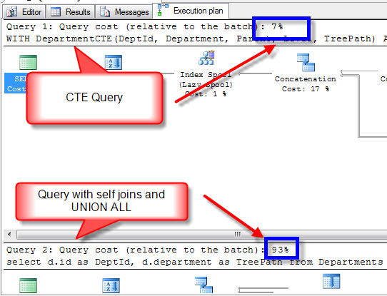

Slide 47
5. Multiple CTE’s In A Single Query
You can include multiple CTE's by comma seperating them:
;WITH firstCTE (query goes here),
secondCTE (second query goes here)
SELECT * FROM firstCTE
INNER JOIN secondCTE on ....

Slide 48
Steps to add a Second CTE
Add a comma at the end of the first CTE, after the closing parentheses.
After the comma, on the next line, declare the name of the new CTE.
After the name of the new CTE add the optional columns declaration.
Add the AS keyword followed by opening and closing parentheses.
Inside of the parentheses add the new CTE query.
Call the CTE query from the outer SELECT statement.

Slide 49
Demo: Multiple CTE
;WITH Fnames (Name) AS
(SELECT 'John' UNION Select 'Mary' UNION Select 'Bill'),
Minitials (initial) AS
(SELECT 'A' UNION SELECT 'B' UNION SELECT 'C'),
Lnames (Name) AS
(SELECT 'Anderson' UNION Select 'Hanson' UNION Select 'Jones')
SELECT F.Name, M.initial, L.Name
FROM Fnames F
CROSS JOIN Lnames as L
CROSS JOIN Minitials m;

Slide 50

Nested CTE’s
Russian Dolls – матрёшки
Pronounced Ma-Trosh-Key.
A Nested CTE query can only reference itself or CTE queries declared earlier in the query.

Slide 51
Nested CTE Example
;WITH cte0 AS
(select 1 as num)
, cte1 AS
(SELECT * FROM cte0)
, cte2 AS
(SELECT * FROM cte1)
SELECT *
FROM cte2;

Slide 52
6. Other Common CTE Uses
Data paging on a search result (Chapter 7 in the CTE Book)
Information on the dates in a year
Creating a replacement for a Numbers table
Breaking up or parsing strings into tables
Query String
SQL Server connect string
Simplifying or breaking up a huge query

Slide 53
Data Paging
To achieve data paging without CTE it usually involves selecting TOP x, then TOP 2x then top 3x, each time taking longer and longer to get to the data that is needed.
Data paging can be simplified and not a challenge to create with CTE’s.
TSQL 2012 introduces the OFFSET and FETCH keywords which is easier to use than a CTE for data paging, and more efficient.

Slide 54
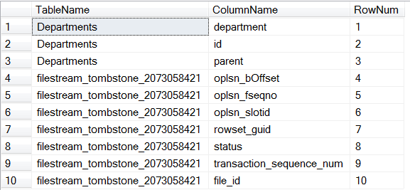
Data Paging Page 1

Slide 55
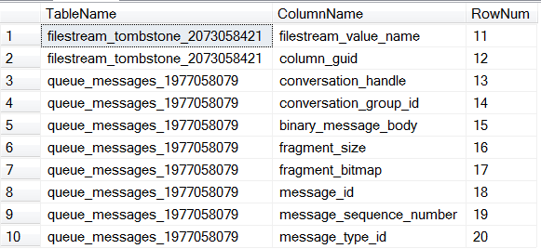
Data Paging Page 2

Slide 56
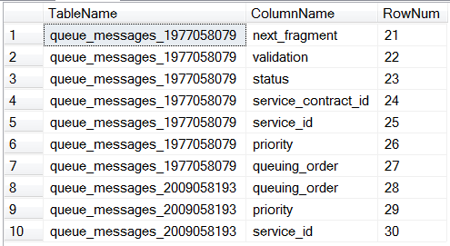
Data Paging Page 3

Slide 57
Demo: Data Paging
;WITH TablesAndColumns AS (
SELECT OBJECT_NAME(sc.object_id) AS TableName,
name AS ColumnName,
row_number()
OVER (ORDER BY object_name(sc.object_id))
AS Row
FROM sys.columns sc )
SELECT *
FROM TablesAndColumns
WHERE Row BETWEEN (@pageNum - 1) * @pageSize + 1
AND @pageNum * @pageSize ;

Slide 58
Demo: SQL Server 2012 Data Paging
SELECT OBJECT_NAME(sc.object_id) AS TableName,
name AS ColumnName
FROM sys.columns sc
ORDER BY TableName
OFFSET (@pageNum - 1) * @pageSize ROWS
FETCH NEXT @pageSize ROWS ONLY;
An alternative to CTE’s if you are using SQL Server 2012

Slide 59
Information on the dates in a year
;WITH DatesCTE as (
SELECT cast('2011-01-01' as date) as CalendarDate
UNION ALL
SELECT dateadd(day , 1, CalendarDate) AS CalendarDate
FROM DatesCTE
WHERE dateadd (day, 1, CalendarDate) < '2012-01-01'
)
SELECT
CalendarDate,
…
CalendarYear=year(CalendarDate),
DayOfWeek=datepart(weekday, CalendarDate)
FROM DatesCTE
OPTION (MAXRECURSION 366);

Slide 60
Creating a replacement for a Numbers table
;WITH NumbersCTE (N) AS
( SELECT 1
UNION ALL
SELECT 1 + N
FROM NumbersCTE
WHERE N < 1000
)
SELECT N
FROM NumbersCTE
OPTION (MAXRECURSION 0);

Slide 61
Breaking up or parsing strings into tables
Query String
Key1=Value1&Key2=Value2&Key3=Value3
SQL Server connect string
server=myserver;user id=sa;password=asdfasdfasdasdffjfjfj

Slide 62
Simplifying huge queries
Whether you like it or not, eventually you will end up with a really huge query
CTE can be used to break up the huge query into smaller components that might be easier to understand than the one huge query

Slide 63
7. Manipulating Data with a CTE
Update
Delete
Insert

Slide 64
Update
When it is run against the CTE the UPDATE changes the base tables inside of the CTE.
Update works with a single base table CTE.
Update does work with multiple base tables as long as only one base table is being changed.
Update doesn’t work if there are no base tables.

Slide 65
Update Example – Single Base Table CTE
;WITH departmentsCTE(id, department, parent) AS
(
SELECT id, department, parent
FROM Departments
)
UPDATE DepartmentsCTE
SET department = 'Bike Locks'
WHERE id = 11;
SELECT * FROM Departments;

Slide 66
Update Example – No Base Table CTE
;WITH NumbersCTE (N) AS
( SELECT 1
UNION ALL
SELECT 1 + N FROM NumbersCTE
WHERE N < 1000
)
UPDATE NumbersCte
SET N = N + 1
OPTION (MAXRECURSION 1000);
Throws an error

Slide 67
Delete
The CTE syntax does not allow for a DELETE statement to be used in any of the queries inside of the CTE
DELETE statement can run in an outer query.
The DELETE statement effects the records that were produced by the CTE
Deleting from a CTE gets very interesting…
A DELETE from the outside query of a CTE will delete from the table inside of the CTE

Slide 68
Delete Example
WITH departmentsCTE(id, department, parent) AS
(
SELECT id, department, parent
FROM Departments
)
DELETE FROM departmentsCTE
WHERE parent = 1;

Slide 69
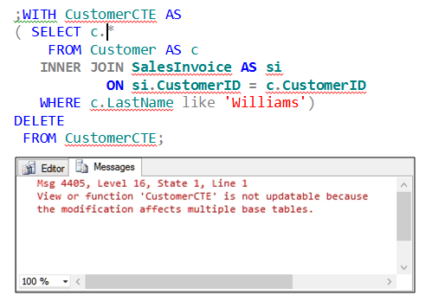
Where Delete Doesn’t Work with a CTE
A CTE with multiple base tables doesn’t support the delete syntax.

Slide 70
Insert
The insert statement can be used to insert into a CTE when the CTE references a single base table

Slide 71
Insert - Demo
;WITH departmentsCTE(id, department, parent) AS
(
SELECT id, department, parent
FROM Departments
)
INSERT INTO DepartmentsCTE
VALUES (99, 'xyz', 1);

Slide 72
9. CTE For Math Geeks
CTE Fibonacci sequence
CTE Factorial

Slide 73
Fibonacci sequence
0, 1, 1, 2, 3, 5, 8, 13, 21, 34, 55, 89, 144 …
By definition, the first two numbers in the Fibonacci sequence are 0 and 1, and each subsequent number is the sum of the previous two.

Slide 74
Demo: Fibonacci Sequence
;WITH Fibonacci (PrevN, N) AS
( SELECT 0, 1
UNION ALL
SELECT N, PrevN + N
FROM Fibonacci
WHERE N < 1000000000)
SELECT PrevN as Fibo
FROM Fibonacci
OPTION (MAXRECURSION 0);

Slide 75
Factorial
The factorial of a positive integer n, written n!, is the product of all the positive integers from 1 up to and including n
Example:
1! = 1
2! = 1 * 2 = 2
3! = 1 * 2 * 3 = 6
4! = 1 * 2 * 3 * 4 = 24

Slide 76
Demo: Factorial
;WITH Factorial (N, Factorial) AS
( SELECT 1, cast(1 as BIGINT)
UNION ALL
SELECT N + 1, (N + 1) * Factorial
FROM Factorial
WHERE N < 20
)
SELECT N, Factorial
FROM Factorial
OPTION (MAXRECURSION 0);

Slide 77
Frequent CTE Questions: Execution
Does a query that JOINs a CTE to itself execute the CTE query once or twice:
TWICE. To confirm write a CTE, JOIN several times, look at the execution plan.

Slide 78
Frequent CTE Questions: View
How does the performance of a CTE compare to the performance of a view?
The question assumes that we are not doing a recursive CTE, since you can’t do recursion with an view.
They have similar performance.

Slide 79
In Review
What is a Common Table Expression
Simple CTE
CTE instead of a Derived Table
Recursive CTE
Multiple CTEs in a Query
CTE Common Uses
Manipulating Data with a CTE
CTE for Math Geeks
79 |

Slide 80
More Information
Follow me on Twitter
@SqlEmt
Visit my website
http://SteveStedman.com/
http://DatabaseHealth.SteveStedman.com
Send me an email:
Steve@SteveStedman.com
Download Slides and Sample TSQL
http://stevestedman.com/speaking/

Slide 81
Common Table Expressions Book
Published May 2013
Available at Amazon.com and at Joes2Pros.com
Printed and Kindle versions are both available now

Slide 83
CTE – Fact or Fiction
Steve Stedman
Debunking common myths about
Common Table Expressions

Slide 84
1. CTE Executions
As a named result set, the CTE is only run once even if it is referenced multiple times in a query.
True or False?
FALSE The CTE is executed once for EACH time that it is referenced in a query.

Slide 85
1. CTE Executions Explained
;WITH deptCTE(id, department, parent) AS
(SELECT id, department, parent
FROM Departments)
SELECT q1.department, q2.department
FROM deptCTE q1
INNER JOIN deptCTE q2 on q1.id = q2.parent
WHERE q1.parent is null;
In this example the deptCTE is executed twice

Slide 86
2. CTEs are proprietary
CTEs are proprietary to Microsoft SQL Server.
True or False?
FALSE Common Table Expressions are supported by several major database platforms, among them PostgreSQL, DB2, Oracle and SQL Server, defined in SQL-99 spec

Slide 87
3. CTE and Hierarchical Queries
CTEs are a great way to create recursive hierarchical queries.
True or False?
TRUE Recursive hierarchical queries are easy to write with a CTE. CTE’s save time, are easy to follow, and work great for hierarchical data.

Slide 88
5. Database Versions
SQL Server only supports CTE’s on SQL Server Enterprise Edition 2008R2 and newer.
True or False?
FALSE Common Table Expressions have been supported since SQL Server 2005 and are available in all versions.

Slide 89
6. Stored Procedures and Functions
CTEs can be defined in user-defined routines, such as functions, stored procedures, triggers, or views.
True or False?
TRUE Common Table Expressions can be defined and used inside of stored procedures and functions.

Slide 90
7. CTEs and Nesting
CTEs can be nested and one CTE can reference an earlier CTE.
True or False?
TRUE Common Table Expressions can be nested. Just define multiple CTE’s and reference an earlier CTE from a later one.

Slide 91
8. Indexing CTEs
Indexes can be added to CTEs to boost performance.
True or False?
FALSE A Common Table Expression is a temporary, "inline" view - you cannot add an index to a CTE.

Slide 92
9. VIEW vs CTE
Which performs better, a non-recursive CTE or a VIEW?
They are the same.
The big gain is the recursive CTE, which you can’t achieve with a view.

Slide 93
10. CTE’s and Data Paging
CTE’s are a great way to do Data Paging for a result grid.
True or False
It Depends…...
SQL Server 2012 has the new OFFSET and FETCH clause on select statements, which is easier than CTE’s. For 2005, 2008 and 2008R2 the CTE is the best option.

Slide 94
11. CTE’s performance
Recursive CTE’s perform the same as other pseudo recursive solutions?
True or False
FALSE…...

Slide 95
12. CTE’s and TempDB
CTE’s are similar to Temp Tables or Table Variables in their use of TempDB?
True or False
FALSE Temp Tables and Table Variables both use TempDB, CTE’s do not…...
See my blog posting for all the details on this one.
http://stevestedman.com/?p=2053
It is more than we have time to prove today.

Slide 96
13. Data Paging
An alternative to a CTE would be to use the ROW_NUMBER function in the WHERE clause to filter the results.
True or False?
FALSE ROW_NUMBER can be used to get the current row number in the result set, but it is a windowing function, and windowing functions are not allowed to be used in the WHERE clause.

Slide 97
More Information
Follow me on Twitter
@SqlEmt
Database Health Project
http://DatabaseHealth.SteveStedman.com
Visit my website
http://stevestedman.com/
Send me an email:
Steve@SteveStedman.com
Download Slides and Sample TSQL
http://stevestedman.com/speaking/

Slide 98
Common Table Expressions Book
Published May 2013
Available at Amazon.com and at Joes2Pros.com
Kindle version available soon

